Slide 1

2023-2024 Fiscal Year Budget
Manson School District No. 19
Notes:
Disclaimer:
There is a huge amount of data and background information in this presentation, so I’m going to skip through some slides. Its good information to have available but I don’t think its necessary to spend time in the meeting detailing information that you might already know or is presented is multiple ways.
The whole presentation I refer to the fiscal year, which in a school district runs from September 1 to August 31.

Slide 2
What are the budgets for Manson School District?
The District has five separate funds that must be budgeted for:
The General Fund contains all financial resources except for those required by Law to be accounted for in other funds. Revenues are primarily from state funds, special maintenance and operations levy funds, federal funds, and local fees. Expenditures include salaries and benefits costs, and non-labor costs such as supplies and instructional materials, utilities, fuel, insurance, and printing costs.
The Capital Projects Fund provides for acquisition of land/buildings and, major upgrades of facilities, and construction of new facilities. This fund is generally financed from the sale of bonds, transfers from the General Fund, and special capital levies.
The Debt Service Fund provides for the redemption and payment of interest on bonds. This fund is typically kept at a very low balance, except when a debt payment comes due.
The Associated Student Body (ASB) Fund accounts for the student extracurricular activities in each school. Revenues are generated, in part, by fees from students and nonstudents attending any optional noncredit extracurricular event of the district. Although the ASB fund is under the control of the Board of Directors, the ASB prepares and submits a revenue and expenditure plan for Board approval.
The Transportation Vehicle Fund accounts for the purchase of or major repair of pupil transportation equipment/buses. The Transportation Vehicle Fund is financed by state reimbursement to school districts for depreciation of approved pupil transportation equipment/buses.
Notes:
The District have five funds that must have an adopted budget:
General fund that contains everything except what must be legally accounted for otherwise
Capital Projects which is for major land and facility purchases or upgrades
Debt Service to make debt payments
ASB for ASB activities
Transportation Vehicle Fund which is to fund school buses

Slide 3
Global Ends Policy # 1
Mission Statement
The mission of the Manson School District is Continuous Student Learning.
Vision Statement
We envision a compassionate and challenging school environment where students:
Are valued as individuals;
Stretched to achieve their full potential;
Understand and contribute to the world they live in;
Acquire the social skills to be successful in a complex and rapidly changing world;
Are well nourished, safe and nurtured
Notes:
The District have five funds that must have an adopted budget:
General fund that contains everything except what must be legally accounted for otherwise
Capital Projects which is for major land and facility purchases or upgrades
Debt Service to make debt payments
ASB for ASB activities
Transportation Vehicle Fund which is to fund school buses

Slide 4
Notes:
First, a note on the 21-22 budget:
During budget preparations last year, the early learning center project wasn’t expected to go forward so only two thousand of capital expenditures were budgeted for. Because we were able to proceed with the project, we’ve actually expended closer to 2 million this year.
This means we’ll need to do a budget extension on our capital projects fund, which we will talk more about next month. There aren’t any negative consequences to a budget extension, we just need to have formal board action to show the state that we are allowed to exceed our budget authority, both on the expenditure side and the revenues to account for the new bond.
Now on to 22-23:
The estimated beginning balance includes the receipt of our new bond, which will be received by July 26th.
As of June 30, 2022 there is about one million two hundred ten thousand left to complete our ELC project. Depending on what our July and August bills look like, our budgeted expenditures will exceed actual by at least 44 thousand, but could be as much as 1 million. This gives us plenty of room in the budget if anything comes up during the year that we’d like to spend down and will also help us avoid doing a budget extension next year.
Last thing of note is the one hundred fifty two thousand dollar transfer out. This transfer will go into the debt service fund and will be used to make our first payments on the new bond in December 2022 and June 2023.

Slide 5
Notes:
Our practice at Manson is to transfer debt service funds from the borrowing fund to the debt service fund as payments come due. The transfers in are shown in the debt service budget as “9000 Other Financing”. Actual interest payments will be lower than budgeted based on actual results of our new bond terms.
As of June 2022, we have four hundred sixty eight left on our bond for the Leffler property.

Slide 6
Notes:
The goal with the ASB Fund is to have each individual club complete their own budgets which would then be complied into one overarching ASB budget, however there is a fair amount of capacity built into the budget for new clubs or activities the ASB would like to start. Most of that capacity is sitting in Athletics right now, which is why there is such a significant increase from the prior year, but it can be used for any ASB activity.

Slide 7
Notes:
The TVF fund is specifically set up for the operation and maintenance of buses. Each year we receive a depreciation payment from the state that is based on the age and purchase price of our current buses, which is the primary source of revenue in this fund.
The biggest thing of note in our TVF is that it’s a zero-based budget, which is a change from prior years. This does not mean we have to spend down the whole fund balance, but it gives us the option if we want or need to. Unless Eric has something up his sleeve, we likely won’t make any expenditures out of this fund in 21-22, which is why there is such a difference between the prior budget ending balance and the current budget beginning balance.

Slide 8
What about the Scholarship Funds?
Manson School District has a Trust & Agency Fund that is made up of our separate scholarship funds:
Freer
Leffler
Beresford
These funds are held in trust and are not considered property of the District. Because of this, we are not required to adopt a budget for this fund.
Notes:
We aren’t legally required to adopt a budget for our trust funds because they aren’t technically our funds. However, we typically give $20,000 in scholarships each year, so we can do a rough estimate of the expected ending balance.
Percy and Margaret Freer – One $1,000 scholarship
Ted and Nicki Leffler – Five $1,000 scholarships
Charlie and Virginia Beresford – Two $5,000 scholarships

Slide 9
General Fund Overview
Fiscal Year 2023-2024
Notes:
Questions on any of the other funds? If not, we’ll get into the general fund.

Slide 10
Notes:
This is our snapshot of the general fund budget for 22-23. There is an overall increase in expenditures due to the 5.5% IPD increase statewide, but otherwise things are generally on track with prior years.
In terms of budgeting, “capacity” is just extra room built into the budget to allow for new programs or grants without the need for a budget extension. Our capacity is shown in revenue under 2000 Local Non-Tax and in expenditures under 70 Other Instructional Programs. This year I have included seven hundred fifty thousand of capacity, which is about 6% of expenditures. The key to having capacity budgeted like this is that we would only use it if we got a whole new program that includes a revenue piece, rather than using it as emergency funds to cover areas exceeding budget.

Slide 11
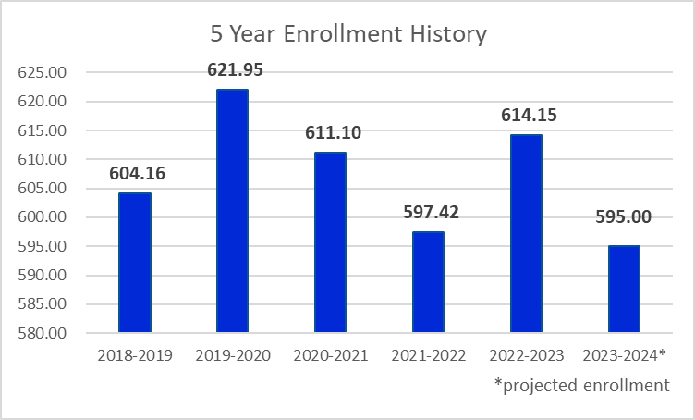
How is our enrollment?
In Washington State, enrollment drives the amount of state-provided funding school districts receive. Manson has seen volatile enrollment numbers over the past several years, which were exacerbated by the effects of the COVID-19 pandemic.
We budgeted conservatively with 585 FTE for the 2022-2023 year, however we ended the school year with an FTE of 614.15.
Notes:
We’ve talked a lot about enrollment this year and how our funding is partially driven by this number, so this is old news at this point. We have seen volatile enrollment for several years, partially due to the effects of the pandemic. We ended 21-22 with an average 597.42 FTE, which is higher than our budgeted 585.
We budgeted our enrollment conservatively for 22-23 at 585 again, with hopes that we will end the 22-23 fiscal year higher than anticipated.

Slide 12
Ends Policy #2a - HIGH ACADEMIC ACHIEVEMENT
Each student will:
Read, write, speak, listen, write with skill and communicate effectively;
Know the core concepts of mathematics and utilize them in integrated and real world applications;
Know the core concepts of earth, physical and life sciences and utilize them in integrated and real world applications;
Know the core concepts of civics, history, geography and global economic issues and utilize this knowledge in civic participation and safeguarding of our democratic principles;
Know, experience and gain an appreciation of the arts:
Know the core concepts of health, nutrition and physical fitness and utilize them in real world applications;
Learn at least a year’s worth of content and skills in a year’s worth of time.
Notes:
The District have five funds that must have an adopted budget:
General fund that contains everything except what must be legally accounted for otherwise
Capital Projects which is for major land and facility purchases or upgrades
Debt Service to make debt payments
ASB for ASB activities
Transportation Vehicle Fund which is to fund school buses

Slide 13
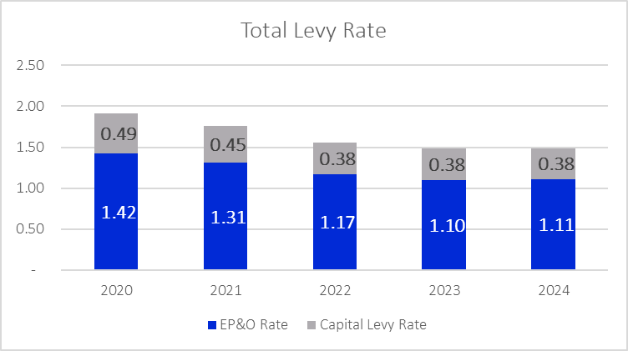
What is the status of our levies?
The District currently has two levies in effect.
Our Educational Programs and Operations (EPO) Levy was approved by voters on February 14, 2023 to continue to fund education programs and operations not funded by the State. The following collections were approved:
2024 – $1,884,500
2025 – $1,955,326
Our Capital Projects Levy was approved by voters on February 12, 2019 to build a new Early Learning Center, renovate existing facilities, and fund technology. The following collections were approved:
2020 – $499,000
2021 – $499,000
2022 – $499,000
2023 – $499,000
2024 – $499,000
2025 – $499,000
Notes:
First thing to note is that levies run on a calendar year rather than our fiscal year, so we are right in between the 2022 and 2023 levy years. We currently have two levies in effect for this fiscal year, our EPO levy and our capital levy.
We are entering the last year of our two year EPO levy so we will want to consider running another EPO levy this year to make sure we don’t have a lapse in funding in the 23-24 fiscal year.
We are also about halfway through the collection of our capital levy, which has been funding needed capital projects around the district.

Slide 14
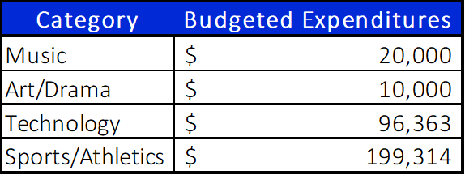
Ends Policy #2b - PERSONAL SKILLS DEVELOPMENT
Each student will:
Be proficient in the application of current technology;
Experience personal pursuits such as music, art, drama, technology, service to others, sports or other opportunities;
Gain knowledge of other cultures and learn to communicate, read and write in second language;
Understand the importance of work and finance and how performance, effort and decisions directly affect future career and educational opportunities;
Think analytically, logically and creatively, and integrate experiences and knowledge to form reasoned judgments and solve problems (critical thinking);
Participate in non-school community activities that reflect their understanding of citizenship.
Notes:
The District have five funds that must have an adopted budget:
General fund that contains everything except what must be legally accounted for otherwise
Capital Projects which is for major land and facility purchases or upgrades
Debt Service to make debt payments
ASB for ASB activities
Transportation Vehicle Fund which is to fund school buses

Slide 15
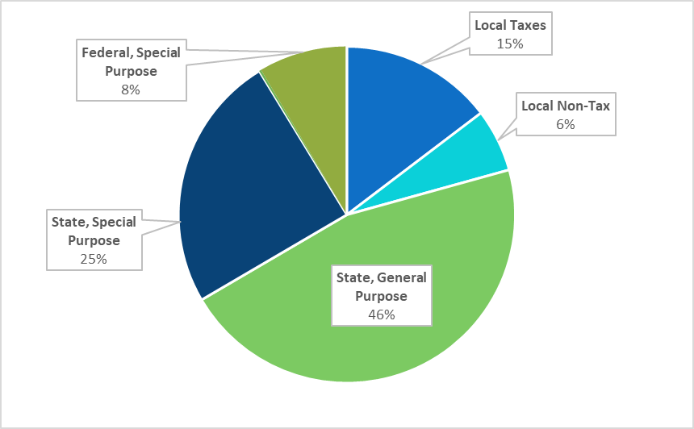
Where does the money come from?
71%, or $9,076,706, comes from the State, which consists of apportionment revenues based on actual enrollment and categorical programs.
8%, or $1,229,144, comes from Federal grants and funding, such as the Every Child Succeeds Act (ECSA) and ESSER programs.
15%, or $1,885,213, comes from Local taxes collected via our approved EPO levy. Because the District's fiscal year runs September 1st to August 31st, portions of two calendar years are used when determining the annual collection.
6%, or $776,333, comes from Local non-tax revenues which include tuition, fees, food service revenues, interest revenues, and facility use fees. This is also where the District budgets capacity for new programs.
Notes:
The chart on this page shows where our revenues are coming from.
71% of our revenues are from the state, either through apportionment or specific state grants. These grants include LAP, state SPED, TBIP.
9% come from federal grants, including Title 1, Migrant ED, federal SPED.
15% come from our EPO levy
6% comes from local-not tax sources, such as food services, tuition fees, and facility use charges

Slide 16
Notes:
Skip to slide 14

Slide 17
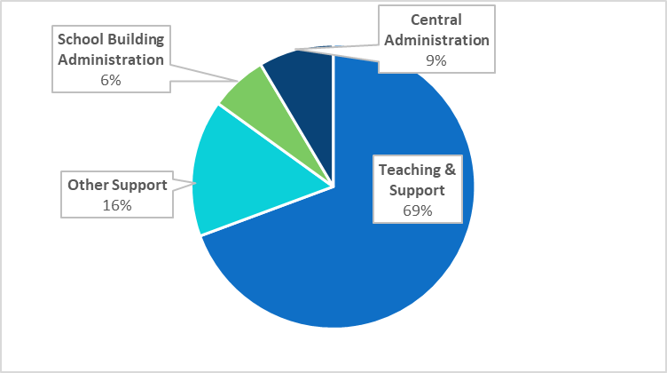
Where does the money go?
69%, or $8,878,682, is spent on teaching and teaching support. This includes funding for teachers, instructional assistants, teaching supplies, materials and textbooks, counselors and librarians, special education and related services, health services, and pupil management and safety.
16%, or $1,994,446, is spent on other school support. This includes operation and maintenance of buildings and grounds, utilities, security, student transportation, nutritional services, insurance, and data processing.
7%, or $834,182, is spent on school building management. This includes principals, assistant principals, secretarial and clerical support, and other expenses related to the management of the school building.
9%, or $1,093,649, is spent on central administration. This includes the expenses of the School Board, Superintendent’s Office, Human Resources, Business Office, and the some supervision activities.
Notes:
The chart on this page shows where our expenditures are spent.
73% of fund are spent on teaching and support. This includes pretty much all activity happening during the day in the schools. Payroll for teachers and paras, supplies and textbooks, SPED services, and health services.
13% is spend on other school support, which is all the ancillary items that occur during the day. Food services, transport, security systems, and ground/utility maintenance.
6% is spend on principals and their secretaries
The remaining 8% is spent on basically all activity happening in the DO, including superintendent costs, business office costs, and other supervision costs.

Slide 18
Ends Policy #2c - SOCIAL SKILLS DEVELOPMENT
Each student will:
Respect diversity and develop an awareness of other cultures;
Be able to think critically and seek information in order to make responsible individual choices regarding sexuality, cyber use and civic involvement;
Develop the character qualities of respect, compassion, honesty, persistence, integrity and service to others;
Be effective communicators who utilize active listening, probing questions and collaborative practices;
Be responsible team members who can think flexibly, are reliable, and exercise creativity in problem solving
Notes:
The District have five funds that must have an adopted budget:
General fund that contains everything except what must be legally accounted for otherwise
Capital Projects which is for major land and facility purchases or upgrades
Debt Service to make debt payments
ASB for ASB activities
Transportation Vehicle Fund which is to fund school buses

Slide 19
Notes:
Skip to slide 16

Slide 20
Notes:
Skip to slide 17

Slide 21
What else do I need to know?
In 2020-2021, the State of Washington Supplemental Budget placed a new requirement on district reporting regarding the use of Materials, Supplies, and Other Contracts (MSOC) funds. This requirement states that as part of the budget development, hearing, and review process required by chapter 28A.505 RCW, each school district must disclose:
The amount of state funding to be received by the District;
The amount the district proposes to spend for materials, supplies, and operating costs;
If (a) exceeds (b): any proposed use of this difference, and how this use will improve student achievement.
Manson School District will receive, inclusive of CTE funding, $1,358,511 in state MSOC funding. We expect to spend $2,639,743 in MSOC, exceeding our state provided funding by $1,281,232.
Notes:
In 20-21, the State placed a new requirement for District's to report how much MSCO funding we will receive from the state, how much we plan to spend, and how we plan to use remaining funds – if any. The intention of this statement is to ensure districts are using funds received for student achievement.
We will receive about $1.2 million and plan to spend about $2.7. We will exceed our provided funding by about $1.5 million.

Slide 22
Ends Policy #2d – SUPPORT OF STUDENT LEARNING
The district will:
Engage with families to make important decisions in their children’s educational pursuits.
        Talking Points – Approximately $2,700 per year
Inform the Manson Community of students’ achievements and progress in learning;
District Media Specialist (Justina Riippi)
Engage all staff in high quality, research-based professional development that increases learning and achievement for each and every student.
  Professional Development – Approximately $170,000
Ensure availability of all materials and resources necessary for each and every student to be successful
  Building Budgets – A total of $150,000 is allocated among the buildings to purchase any materials or supplies needed. Allocation in made based
  on a percentage of the budgeted FTE.
Notes:
The District have five funds that must have an adopted budget:
General fund that contains everything except what must be legally accounted for otherwise
Capital Projects which is for major land and facility purchases or upgrades
Debt Service to make debt payments
ASB for ASB activities
Transportation Vehicle Fund which is to fund school buses

Slide 23
Four Year Budget Projections
F-195F
Notes:
Questions over the general fund budget? If not, we’ll finish up with our four year budget projections.
The four year budget projection is a newer requirement by the state and are meant to give a general idea of where the district projects to be in four years. However, there really isn’t a good way to project that out so this is really just myt best guess of what could happen.

Slide 24
Notes:
We’ll start with the general fund. This first slide is projections of enrollment and staff counts.
The first column is the 22-23 actual budgeted enrollment. The rest of the years were determined by moving each grade level up a year, with some variation. Additionally, staff counts were determined by adding an addition .5 FTE each year.

Slide 25
Notes:
This slide shows our revenues and expenditures, which were determined by increasing our current budget by 2% each year. This is what we can reasonably expect the IPD to be, so it gives us a pretty good estimation.

Slide 26
Notes:
This shows our expected beginning and ending balances for the next four years, which reflect an increase in ending fund balance each year.

Slide 30
Notes:
Like the 22-23 budget, this is set up as a zero based budget.

Slide 31
Questions?
Notes:
Questions over anything we’ve discussed?

